Slide 1

Microsoft Graph 101
Jan Vidar Elven
Microsoft Enterprise Mobility MVP
@skillriver | gotoguy.blog
Notes:
If you are curious about Microsoft Graph, this will get you started. Learn about the basics for querying the Microsoft Graph API, and how to use the Graph Explorer.

Slide 2

Jan Vidar Elven
Enterprise Mobility MVP
Cloud Architect @ Skill AS
@skillriver | gotoguy.blog

Slide 3
Microsoft Graph
What’s in it for me?

Slide 4




Microsoft Graph
DEVICES
SECURITY ALERTS
PARTNER
THREAT INTELLIGENCE
ORGANIZATION
INSIGHTS
ME
ROLES
ADMIN UNITS
CONTENT
ORGANIZATION
REPORTS
GROUPS
USERS
USERS
APPS
CONTACTS
EMAIL
PEOPLE
TEAMS
DOCUMENTS
SITES

Slide 5
Microsoft Graph API
Access user, group, devices, apps and organizational data
One endpoint
One token
All users
Your app
https://graph.microsoft.com
Users
Groups
SharePoint
Outlook
OneNote
Planner
Teams
Excel
Intune
Azure AD
more…

Slide 6
Calling the API
https://graph.microsoft.com
/{version}
/{resource}
/{id}
/{property}
?{query-parameters}
HTTP verbs dictate the request intent: GET | POST | PATCH | PUT | DELETE
Version: /v1.0 or /beta
Resource: /users, /groups, /sites, /drives, /devices, more…
Member from collection: /users/jan.vidar@elven.no
Property: /users/jan.vidar@elven.no/department
Traverse to related resources via navigations: /users/jan.vidar@elven.no/registereddevices
Query parameters: /users/jan.vidar@elven.no/registereddevices?$top=5
Format results: $select | $orderby
Control results: $filter | $expand
Paging: $top | $skip | $skiptoken

Slide 7
Graph Explorer
DEMO
https://aka.ms/GE
https://aka.ms/Graph

Slide 8
App types and permission types
App type
Permission type
Who can consent
Effective Permissions
Get access on behalf of users
Get access as a service
Mobile, Web and Single page app
Service and Daemon
Delegated permission (user permission)
Application permission
Users can consent
for their data
Admin can consent
for them or for all users
Only admin can consent
App permissions
User permissions
App permissions
https://developer.microsoft.com/en-us/graph/docs/concepts/permissions_reference
Notes:
Delegated Permissions
Signed-in User is present
Application Permissions
User is not present (app runs as service or deamon)
Different Permission sets available for Delegated vs Application
Effective Permissions!
https://developer.microsoft.com/en-us/graph/docs/concepts/permissions_reference

Slide 9
Explore EMS via Graph
One Common API
Benefits -> Simplify – Automate - Integrate
Users
Apps
Data
Devices
Notes:
Azure AD and Intune used to have own API’s
Access to Directory and Devices, Apps and Data, as Resources linked to the Microsoft Graph
Benefits:
Simplify, accessible via many platforms and tools
Automate, build workflows and processes
Integrate, with other services or reporting solutions

Slide 10
Serverless with Microsoft Graph
Consume resources from PowerShell or Apps

Slide 11



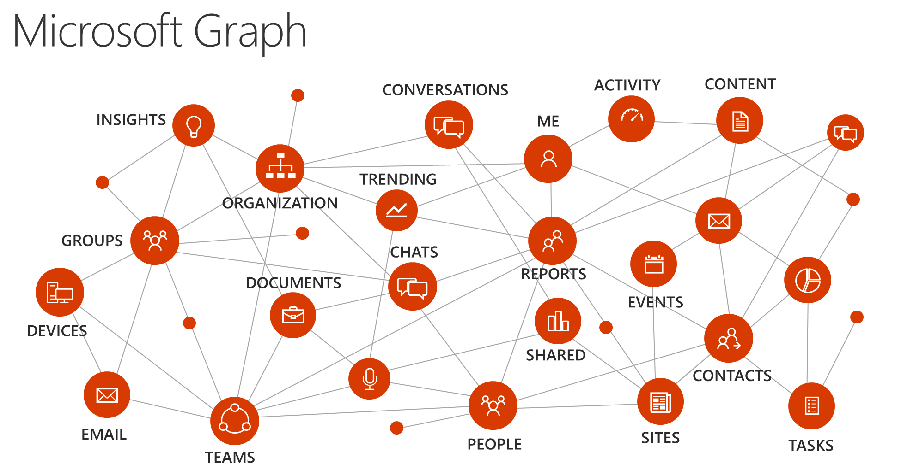


Serverless Apps with Microsoft Graph
PowerApps
Flow
Logic Apps
PowerShell
Azure Functions

Slide 12
Using PowerShell with Microsoft Graph
Mode:
Interactively
Scheduled / Automated
Delegated vs. Application Permissions
Delegated
Application
Notes:
Mode:
Interactively
Scheduled / Automated
Delegated vs. Application Permissions
Application
No user involvement, can be automated/scheduled
Protect credentials!
Delegated
Involves user, best for interactively
Can use Authentication libraries for auth flows

Slide 13
App Registration
Web App/API
Application & Delegated permissions
Native Client
Delegated only

Slide 14
Invoke-RestMethod
Invoke-RestMethod –Method
–Uri
–Headers @{"Authorization"="Bearer "}
Get
"https://graph.microsoft.com/v1.0/users?$filter=Department eq Finance'"
Complete examples at:
https://github.com/skillriver/ExpertsLiveEU2018/tree/master/GraphPowerShell
accessToken
Notes:
tokenPlease()

Slide 15
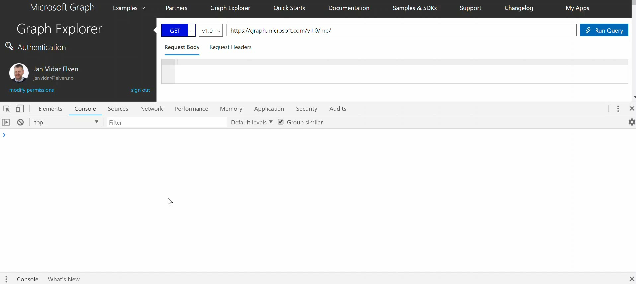
Simple Graph PowerShell Demo

Slide 16
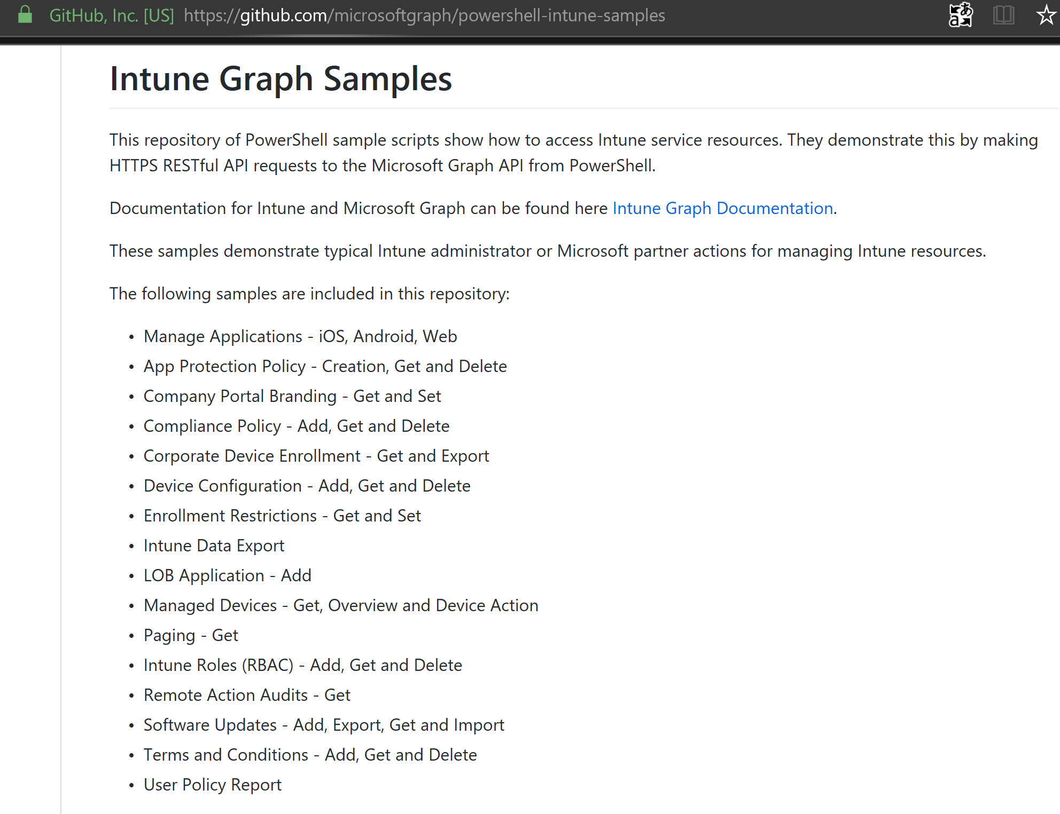
Intune PowerShell Samples
https://github.com/microsoftgraph/powershell-intune-samples

Slide 17













Thank You!
Gold
Silver
Conference Partner

